Slide 1
WELCOME

Slide 2

SHRI SOMESHWAR SHIKSHAN PRASARAK MANDAL’S SHARAD PAWAR INSTITUTE OF TECHNOLOGY, SOMESHWARNAGAR
Presentation On
Capstone Project (SPIOT College Management System)
Team Members Names :-1) Jadhav Sakshi
2) Sutar Rupali
3) Kharade Shravani
4) Rane Isha
Class : TYCO
Mentor Name : Mrs. Nazirkar S.B.

Slide 3
Content
Abstract
System requirement
Introduction
Existing System
Proposed system
System Architecture
Advantages
Future Scope
Application
Conclusion And References
Outputs

Slide 4

Abstract
The Project titled “SPIOT College Management System” is a mobile application developed to maintain the results of the students.
This project contains three modules. student module , teacher module ,principle model.
College SPIOT is an unique app based system that can be used by teachers, students and parents to perform all of their academic activities online through web or app.

Slide 5
System Requirement
Software Requirements:
Android studio
Firebase Database
4.3.Hardware Requirements(minimum): -
Processor - AMD Ryzen 5 3500U
Speed - 1.1 - 3.1 GHz 1.8 GHz
RAM - 8 GB
HDD - 1TB

Slide 6

Introduction:-
It is the combination of student , college and leave application management system.
It is more helpful for the student , teacher, principle, and also parents.
The software design if effectively implemented will solve the problems associated with manual processing of teacher leave application.

Slide 7
Existing System
The main problem projected is that student’s particulars are reported manually searching the all syllabus , exam data , academic calendar , Time Table , Notes.
It takes a lot of time .
No User Friendly.
Manual Operation.
No Security Features.

Slide 8
Proposed System
Student can searching the all data on one application. i.e syllabus , exam data , academic calendar , Time Table , Notes etc.
Teacher can send easily leave application.
It reduces the Time .
More User Friendly.
Automated Operation.
Security Features provided.

Slide 9
System architecture
College Jackpot
Student
Teacher
Principle
Attendance
See All Exam Data
Send Leave Application
Fill Attendance
Receive Leave Application

Slide 10
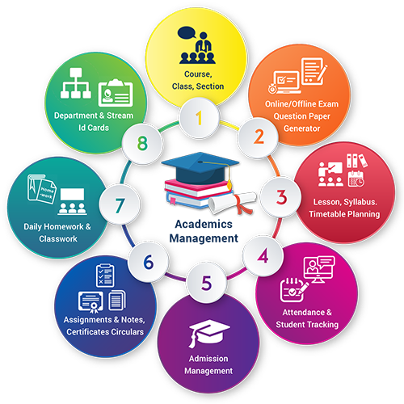
Student Module
First in student module you can see all subject question papers , academic Calendar , syllabus , Timetable and All the Notes.
Also see their attendance in percentage wise.
And fill the attendance.

Slide 11

Teacher & Principle Module
In teacher module teacher can leave application submit to the principal.
See all student Attendance in percentage wise.
Give the attendance access code.
In principal module principal can give the permissions for teachers leave application . They have access the overall application.

Slide 12
Advantages
Improve Efficiency
Better student performance
Smart timetable
Smart communication

Slide 13
Future Scope
Send message to the parent for the attendance.
College new facilities notification.
Fees pending notification.
All MSBTE new updating notification

Slide 14
Application
College
University
Academy
School

Slide 15
Conclusion
we are concluded, this application student can easily access the modules like to see the all subjects questions paper , academic calendar , syllabus ,attendance etc.
The software design if effectively implemented will solve the problems associated with manual processing of teacher leave application.

Slide 16
References
https://www.ibm.com/topics/mobile-application-development
https://developer.android.com/studio/archive
Let us book:- Android Security Cookbook by Keith Makan
Let us book:- Android Programming for Beginners by John Horton

Slide 17
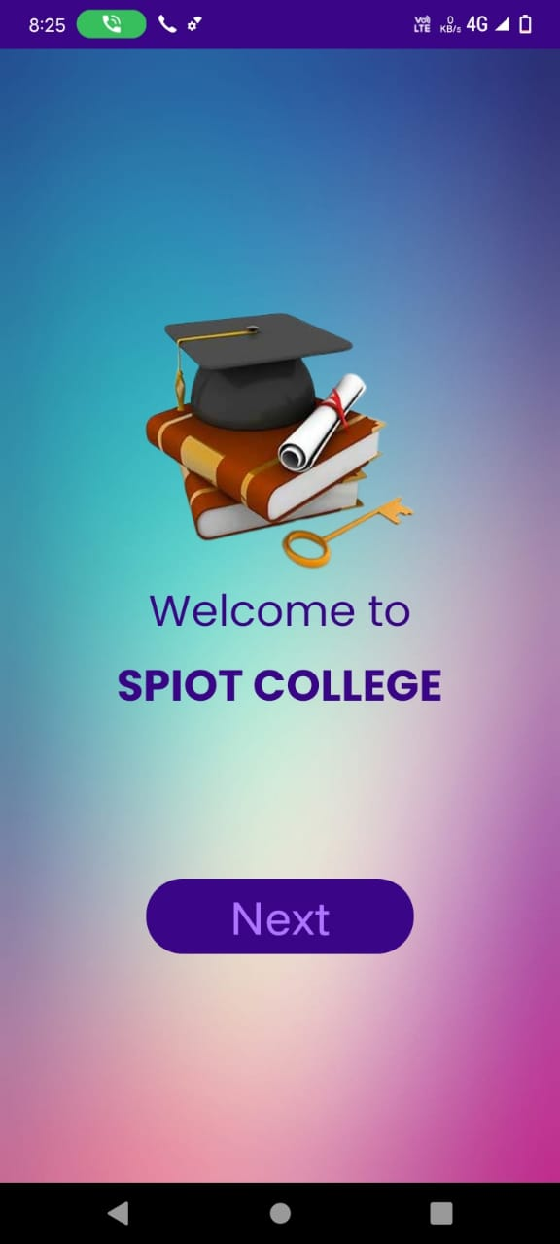
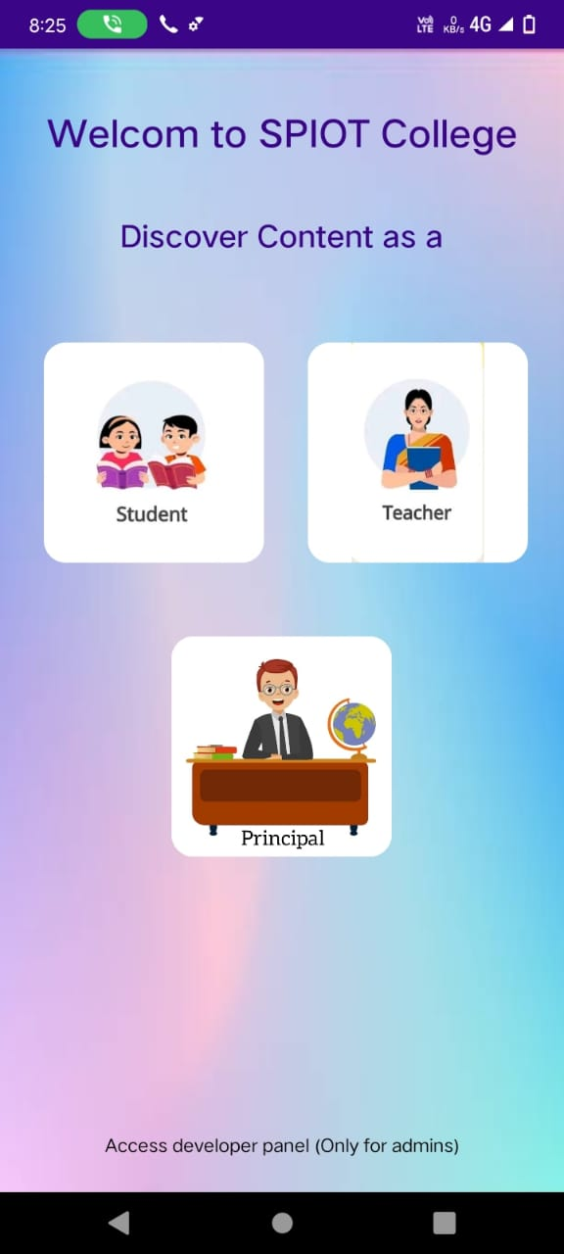
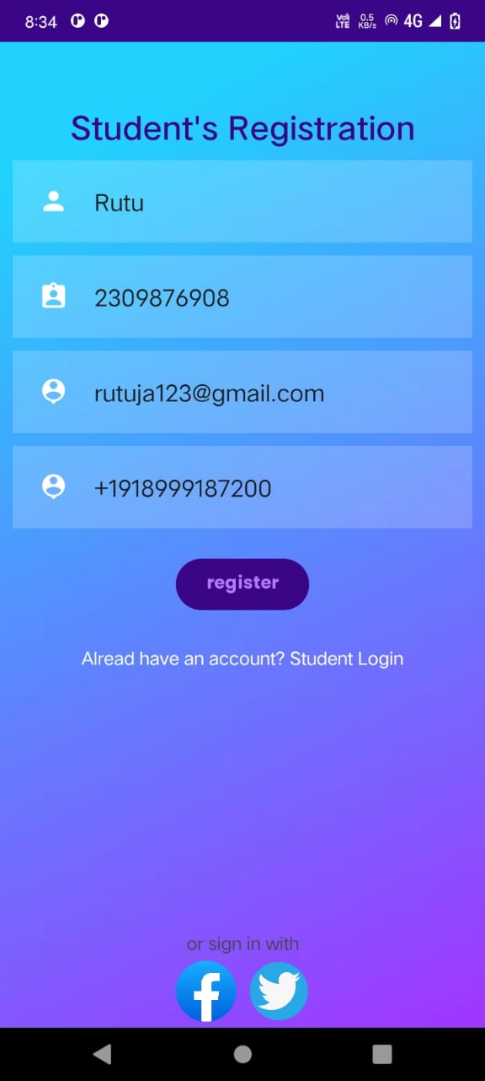
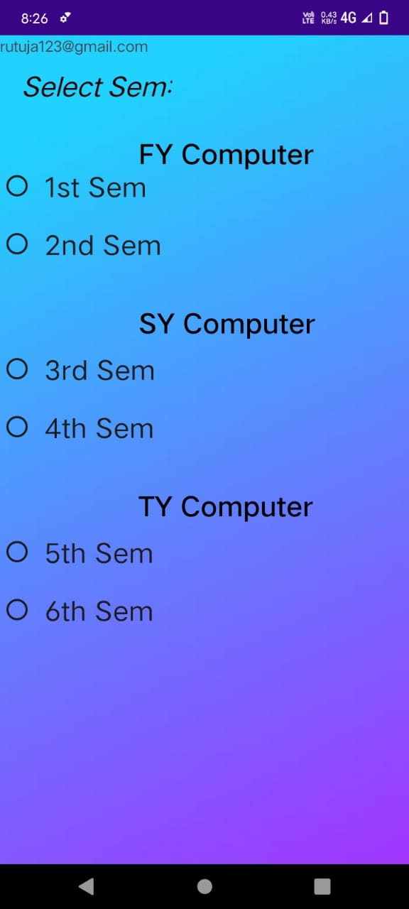
Outputs AS A STUDENT

Slide 18
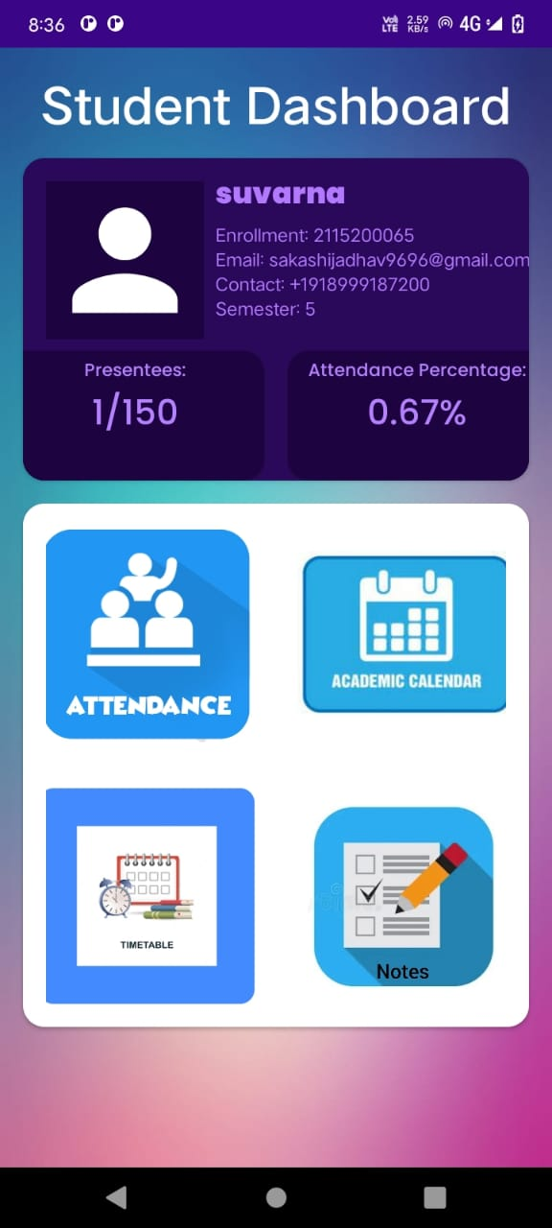
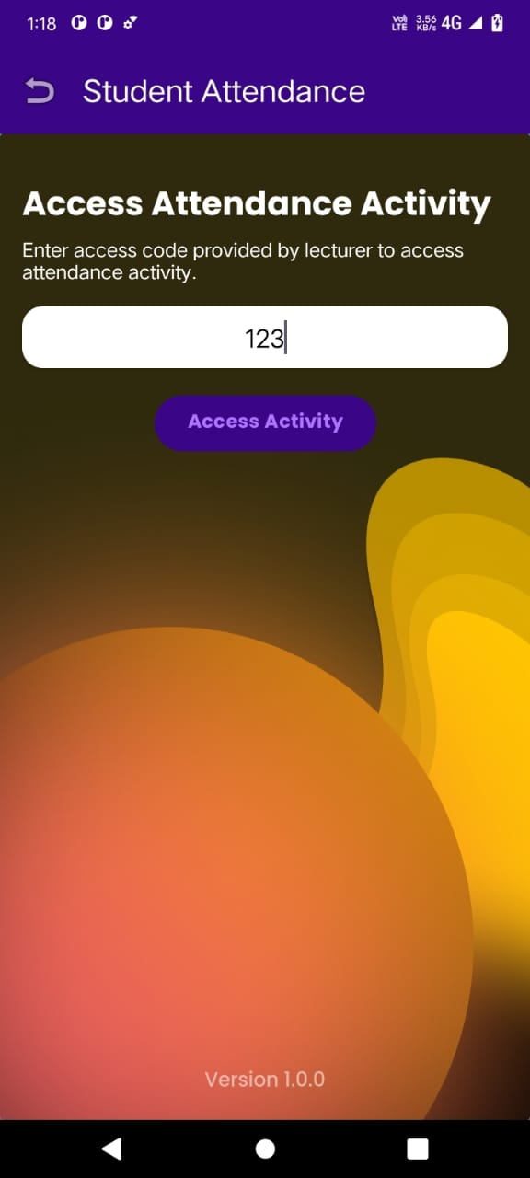
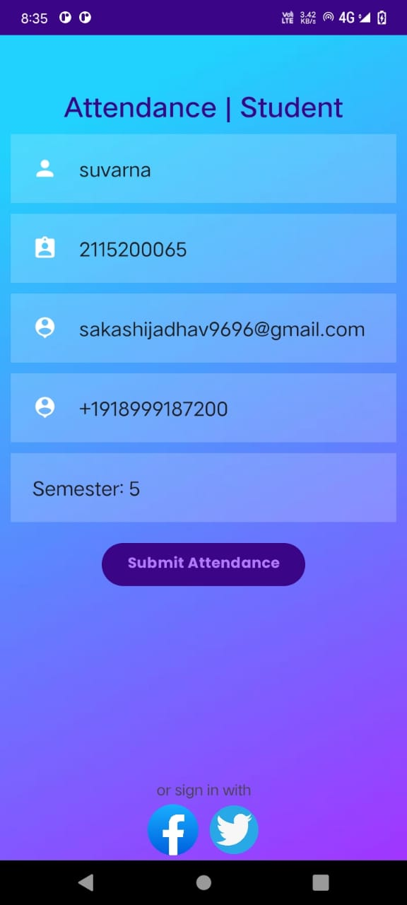

Slide 19
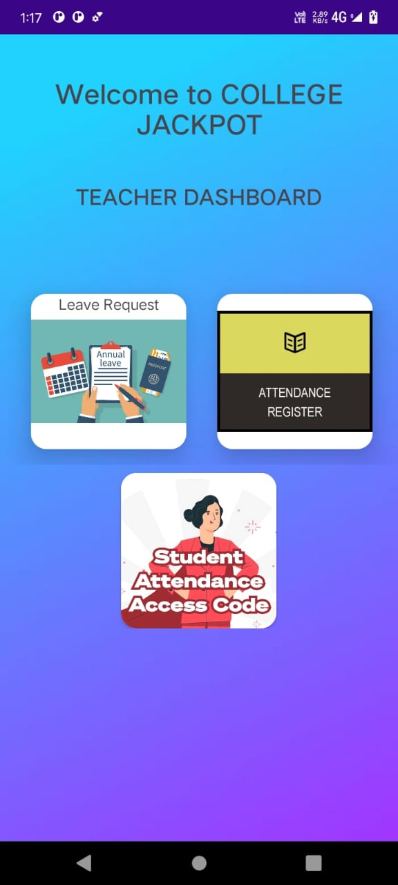
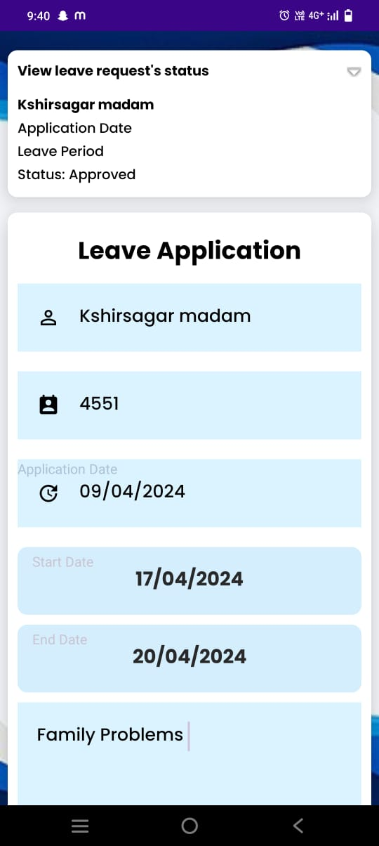
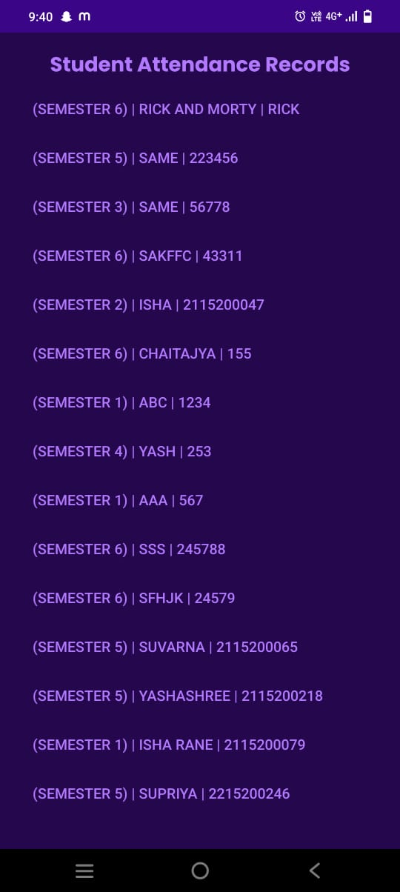
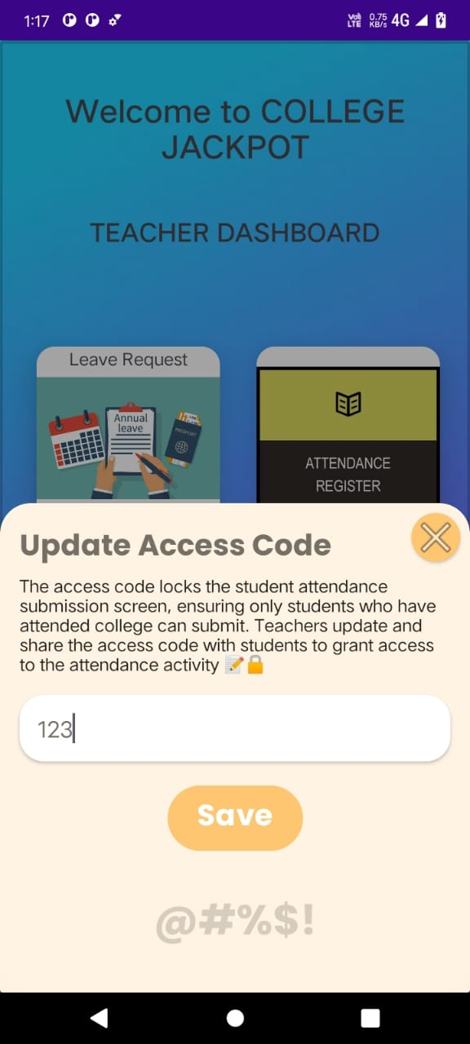
AS A TEACHER

Slide 20
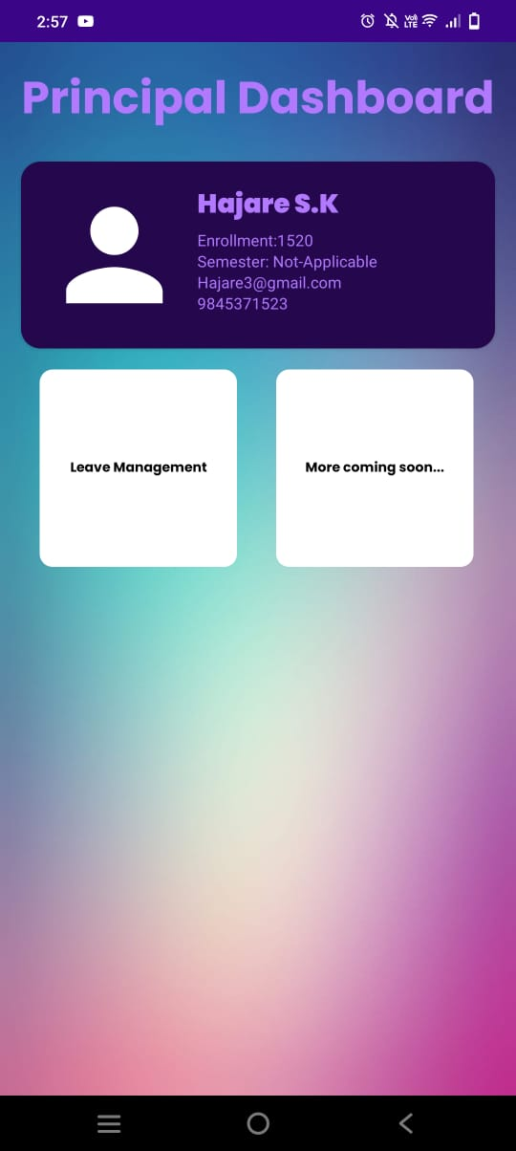
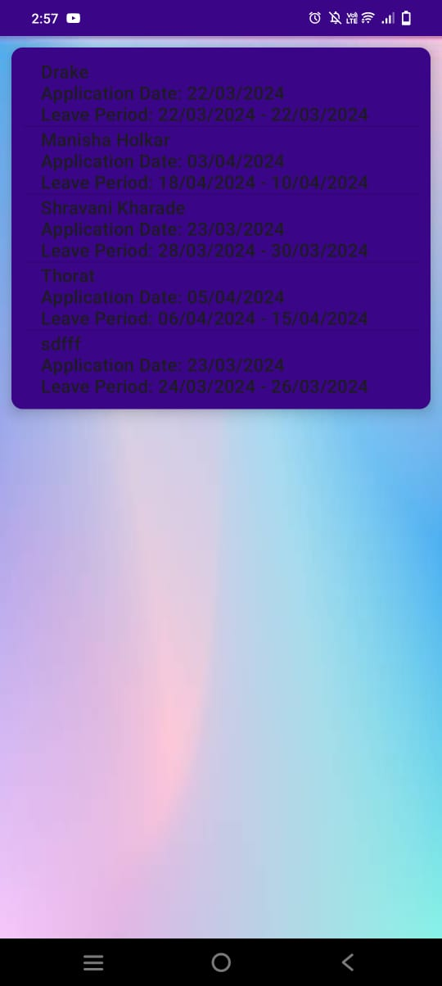
AS A PRINCIPAL

Slide 21
THANK YOU…!

